Slide 1
DBMS PROJECT • 2025-2026
PortfolioMate
A Smart Investment Tracker
React 18
Node.js
Santosh RA2411030030063 Sidharth Sagar RA2411030030076
MySQL 8.0
TypeScript
Guide: Dr. Anirudha Gaikwad | SRM Institute of Science & Technology

Slide 2
Agenda
1
Problem Statement
2
What is PortfolioMate?
Challenges of manual tracking
Overview & objectives
3
System Architecture
4
Database Design (ER + 3NF)
3-tier design
Schema & normalization
5
Tech Stack & Features
6
SQL Queries & Results
Frontend · Backend · DB
Sample outputs
7
Constraints & Testing
8
Conclusion & Future Scope
Data integrity validation
Learnings & enhancements

Slide 3
The Problem with Manual Investing
⏱
Time-Consuming
📊
Fragmented Data
Manually tracking multiple assets across brokerages takes hours every week.
Investments scattered across spreadsheets, statements & portals — no unified view.
⚠
Error-Prone
🤔
Decision Paralysis
Manual calculations lead to incorrect P&L figures, missed opportunities.
Without analytics, investors can't make data-driven financial decisions.

Slide 4
What is PortfolioMate?
PortfolioMate
📈
💰
₿
A centralized, full-stack web application for tracking, managing, and analyzing financial investments in real time. Built on a rigorously normalized MySQL database, it delivers accurate profit/loss insights through an intuitive React dashboard.
Stocks
Mutual Funds
Crypto
📋
📜
🏢
ETFs
Bonds
Real Estate
6 Investment Types Supported

Slide 5
Project Objectives
01
Intuitive Interface
02
Comprehensive Asset Tracking
03
Performance Analysis
User-friendly dashboard for all experience levels with responsive design & dark mode.
Support Stocks, Mutual Funds, Crypto, ETFs, Bonds & Real Estate in one place.
Real-time profit/loss calculations, trend visualizations and portfolio analytics.
04
Data-Driven Decisions
05
Secure Authentication
06
Relational Data Integrity
Organized financial data with actionable insights through interactive charts.
JWT-based auth with bcrypt password hashing protecting sensitive financial data.
3NF normalized MySQL schema with PK, FK, UNIQUE & CHECK constraints.

Slide 6
System Architecture — 3-Tier Design
TIER 1
🖥
Presentation Layer
TIER 2
⚙
Application Layer
TIER 3
🗄
Data Layer
▸ React 18 + TypeScript
▸ Node.js 18+ runtime
▸ MySQL 8.0+ database
▸ Tailwind CSS + shadcn/ui
▸ Express.js REST API
▸ 3NF normalized schema
⇄
⇄
▸ Recharts — interactive graphs
▸ JWT authentication
▸ ACID-compliant transactions
▸ React Router (SPA)
▸ bcryptjs password hashing
▸ Indexed joins for speed
▸ Axios HTTP client
▸ express-validator
▸ MySQL2 Node.js driver

Slide 7
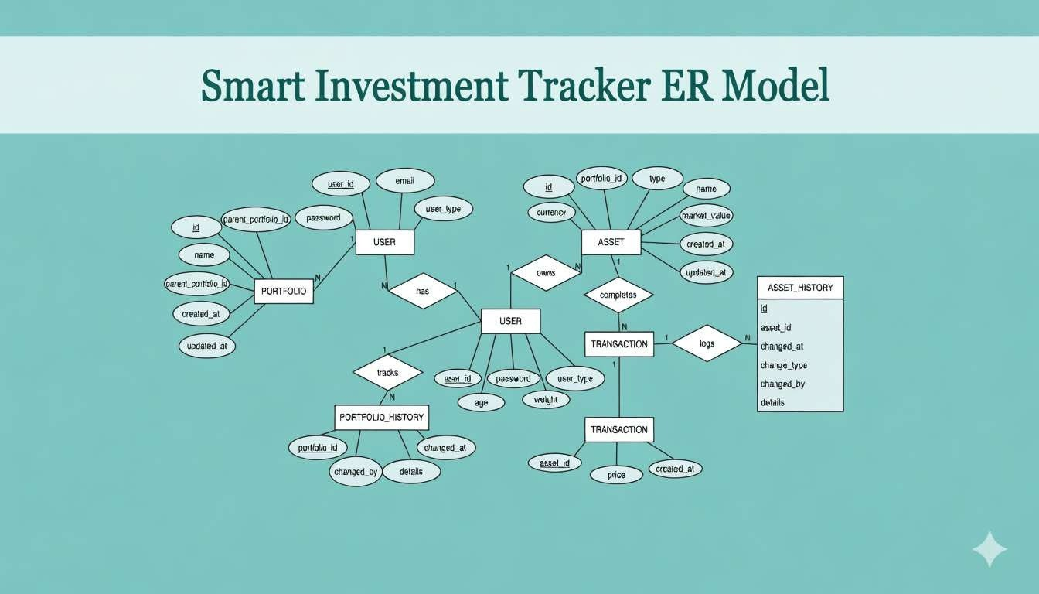

Slide 8
Database Schema — Third Normal Form (3NF)
3NF achieved: Separate tables for User, Portfolio, Asset, Transaction, Portfolio_History & Asset_History → eliminates redundancy, prevents anomalies
users
assets
transactions
Column
Type
Constraint
Column
Type
Constraint
Column
Type
Constraint
user_id
INT
PRIMARY KEY
id
INT
PRIMARY KEY
transaction_id
INT
PRIMARY KEY
name
VARCHAR(100)
NOT NULL
portfolio_id
INT
FK → portfolios
asset_id
INT
FK → assets
email
VARCHAR(150)
UNIQUE, NOT NULL
type
VARCHAR(50)
NOT NULL
quantity
DECIMAL(15,4)
NOT NULL
password
VARCHAR(255)
NOT NULL
name
VARCHAR(200)
NOT NULL
price
DECIMAL(15,2)
NOT NULL
user_type
ENUM
DEFAULT 'investor'
market_value
DECIMAL(15,2)
NOT NULL
transaction_type
ENUM
BUY/SELL

Slide 9
Technology Stack & Key Features
Frontend
Backend
Database
▸ React 18
▸ Node.js 18+
▸ MySQL 8.0+
▸ TypeScript 5
▸ Express.js 4
▸ 3NF Schema
▸ Tailwind CSS
▸ JWT Auth
▸ MySQL2 Driver
▸ Recharts
▸ bcryptjs
▸ ACID Compliant
▸ Vite
▸ express-validator
▸ Indexed Queries
Key Features
🔐 JWT Auth
📊 Live Dashboard
📈 P/L Tracking
🔍 Smart Filter
🌙 Dark Mode
📱 Responsive
📉 Charts & Graphs
🛡 Data Integrity

Slide 10
RESTful API Design
Authentication
Investments
Dashboard Analytics
POST
/api/users/register
GET
/api/investments
GET
/api/dashboard/summary
Register new user
All investments
Portfolio stats
POST
/api/users/login
POST
/api/investments
GET
/api/dashboard/by-type
Login & get JWT token
Add investment
By asset class
GET
/api/users/profile
PUT
/api/investments/:id
GET
/api/dashboard/monthly
Get user profile
Update investment
Monthly trends
PUT
/api/users/change-password
POST
/api/investments/:id/sell
GET
/api/dashboard/top-performers
Update password
Record sell
Best performers

Slide 11
Sample SQL Queries & Output
P&L Calculation Query
SELECT a.name, a.type,
SUM(t.quantity * t.price) AS total_invested,
a.market_value AS current_value,
(a.market_value - SUM(t.quantity * t.price)) AS profit_loss
FROM assets a JOIN transactions t ON a.id = t.asset_id
WHERE t.transaction_type = 'BUY'
GROUP BY a.id ORDER BY profit_loss DESC;
Investment
Type
Invested
Current
P&L
Return %
Reliance Industries
Stock
₹70,000
₹85,000
+₹15,000
+21.43%
Bitcoin
Crypto
₹28,000
₹32,000
+₹4,000
+14.29%
SBI Bluechip Fund
MF
₹40,000
₹42,500
+₹2,500
+6.25%
NIFTY 50 ETF
ETF
₹20,000
₹18,750
-₹1,250
-6.25%

Slide 12
Constraint Enforcement & Data Integrity
Constraint
Applied On
Test Scenario
Result
PRIMARY KEY
All entity IDs
Insert duplicate ID
BLOCKED
UNIQUE
email in users
Register same email twice
BLOCKED
FOREIGN KEY
portfolio_id in assets
Add asset to nonexistent portfolio
BLOCKED
NOT NULL
name, email, password
Insert user without email
BLOCKED
CHECK
age > 0 in users
Insert age = -5
BLOCKED
CASCADE DELETE
assets.portfolio_id
Delete portfolio
AUTO-DELETED
⚡ Dashboard loads in 200–400ms | JWT adds ~5ms | Indexed joins improve query speed by ~60% | 3NF reduces query complexity

Slide 13
Portfolio Analytics & Performance
₹1.79L
Total Portfolio Value
+21.4%
Best Return (Reliance)
4
Asset Classes Tracked
200ms
Avg Dashboard Load

Slide 14
Limitations & Future Enhancements
⚠ Current Limitations
🚀 Future Enhancements
✕ No real-time stock price integration (manual updates only)
🔴 Live Prices
Alpha Vantage / Yahoo Finance API integration
✕ Single currency (INR) — no international portfolio support
🤖 AI Advisor
ML-powered personalized investment recommendations
✕ No mobile native app (responsive web only)
🌍 Multi-Currency
Real-time FX conversion for global portfolios
✕ Dividend tracking not yet implemented
📱 Mobile App
React Native cross-platform iOS & Android app
✕ No automated tax calculation module
📄 Tax Reports
Automated LTCG/STCG tax computation & export

Slide 15
Conclusion
✅
Demonstrated full DBMS lifecycle — ER modelling, normalization to 3NF, constraint enforcement & SQL analytics.
✅
Built a production-grade full-stack app with React + Node.js + MySQL — 6 investment types, real-time P&L.
✅
Indexed queries, 3NF schema & batch API calls deliver a dashboard that loads in under 400ms.
✅
PortfolioMate empowers investors to take data-driven control of their financial future.

Slide 16
Thank You
Santosh
Sidharth Sagar
RA2411030030063
RA2411030030076
Guide: Dr. Anirudha Gaikwad | Dept. of CSE, SRM-NCR Delhi Campus

